Slide 2
Welcome to Chapter 7!
Fostering Healthy, Equitable, and Inclusive Digital Communities

Slide 3
Session Objectives
Identify and describe the five core social-emotional (SEL) competencies and their importance in adult education
Develop practical strategies and tools for integrating SEL into classrooms
Explore techniques for fostering positive relationships with adult learners
Notes:
🕧 = 1 minute
Welcome the group to the session on practical strategies and tools to integrate social and emotional learning (SEL) into classrooms with the goal fostering positive relationships and creating a supportive environment for adult learners.
Introduce today’s focus = SEL, or social and emotional learning.
Review today’s objectives:
Identify and describe the five core SEL competencies and their importance in adult education
Develop practical strategies and tools for integrating SEL into their classrooms, both in-person and online, to create a safe and supportive learning environment for adult learners.
Explore techniques for fostering positive relationships with adult learners, including self-reflection, cultural competence, effective communication, setting high expectations, and involving learners in the learning process.
By the end of this session, we will have built a foundation that can be used to continue developing SEL-informed practices in our programs and classrooms.

Slide 4
Session Agenda
Reflect on social-emotional learning (SEL)
Explore SEL and its importance in Adult Education
Discuss the application and impact of SEL
Identify strategies for creating an SEL-inclusive classroom
Explore next steps
Notes:
🕧 = 1 minute
Today’s agenda includes opportunities to explore theoretical ideas, to share ideas with our peers/colleagues, and to spend time applying key principles of SEL into our classrooms and programs.
Warm-up: Engage participants with a word cloud activity using Mentimeter.
Overview of SEL and Its Importance in Adult Education: Facilitate a guided conversation on the relevance of SEL and the five core competencies.
Small Group Discussion: Participants engage in peer-to-peer discussions on SEL-related questions.
Application Activity: Using Padlet, participants brainstorm practical strategies for creating an SEL-inclusive classroom.
Summary and Next Steps: Recap key takeaways, encourage reflection, and provide resources for further exploration.

Slide 5
Quick Brainstorm
Word Cloud
What words or phrases come come to mind when you think about social and emotional learning?
🗨️ Post your response to this Mentimeter
Notes:
🕧 = 5 minutes
🗣️ Facilitation tip. The purpose of this warm-up activity is to foster a collaborative and supportive environment, encouraging open dialogue and knowledge-sharing. There is no “right” or “wrong” answer, which is important to emphasize.
Also be sure to emphasize that this is kind of a reverse activity. When educators think about social and emotional learning, what words or phrases do NOT belong in that word cloud?
💻 Digital tools connection. Prior to the session, create a Mentimeter word cloud where participants can share their responses.
Link to create a Mentimeter word cloud: https://www.mentimeter.com/features/word-cloud
Link to learn about how to create a Mentimeter word cloud: https://help.mentimeter.com/en/articles/410469-word-clouds
<Store the Mentimeter link here and add to slide above>
🗣️ Facilitation tip. As participants respond, highlight any trends and outliers that you notice:
"Let's explore the word cloud together and see which words appear most frequently. Are there any words that surprise you?"
"Take a look at the word cloud. What are some common themes or ideas you notice?”
"Did anyone notice any outliers or unexpected terms in the word cloud?”

Slide 6
Social and Emotional Learning
What is Social and Emotional Learning?
A focus on SEL helps students:
set and achieve positive goals;
feel and show empathy for others;
establish and maintain positive relationships;
make responsible decisions; and
understand and manage emotions.
Notes:
🕧 = 3 minutes
Define SEL: Social and Emotional Learning involves the development of skills and competencies to recognize and manage emotions, establish positive relationships, make responsible decisions, and set and achieve goals.
Emphasize that SEL is a crucial component for successful participation in learning, life, and work.
Talk through what SEL enables us to do:
set and achieve positive goals;
feel and show empathy for others;
establish and maintain positive relationships;
make responsible decisions; and
understand and manage emotions.
Adult educators know really well that our students bring all kinds of challenges with them to class. We all know how to connect with teachers. With SEL, we're going to formally explore the importance of that connection, and discover some new ideas for deepening those connections to make our classrooms more accessible, inclusive, and effective.

Slide 7
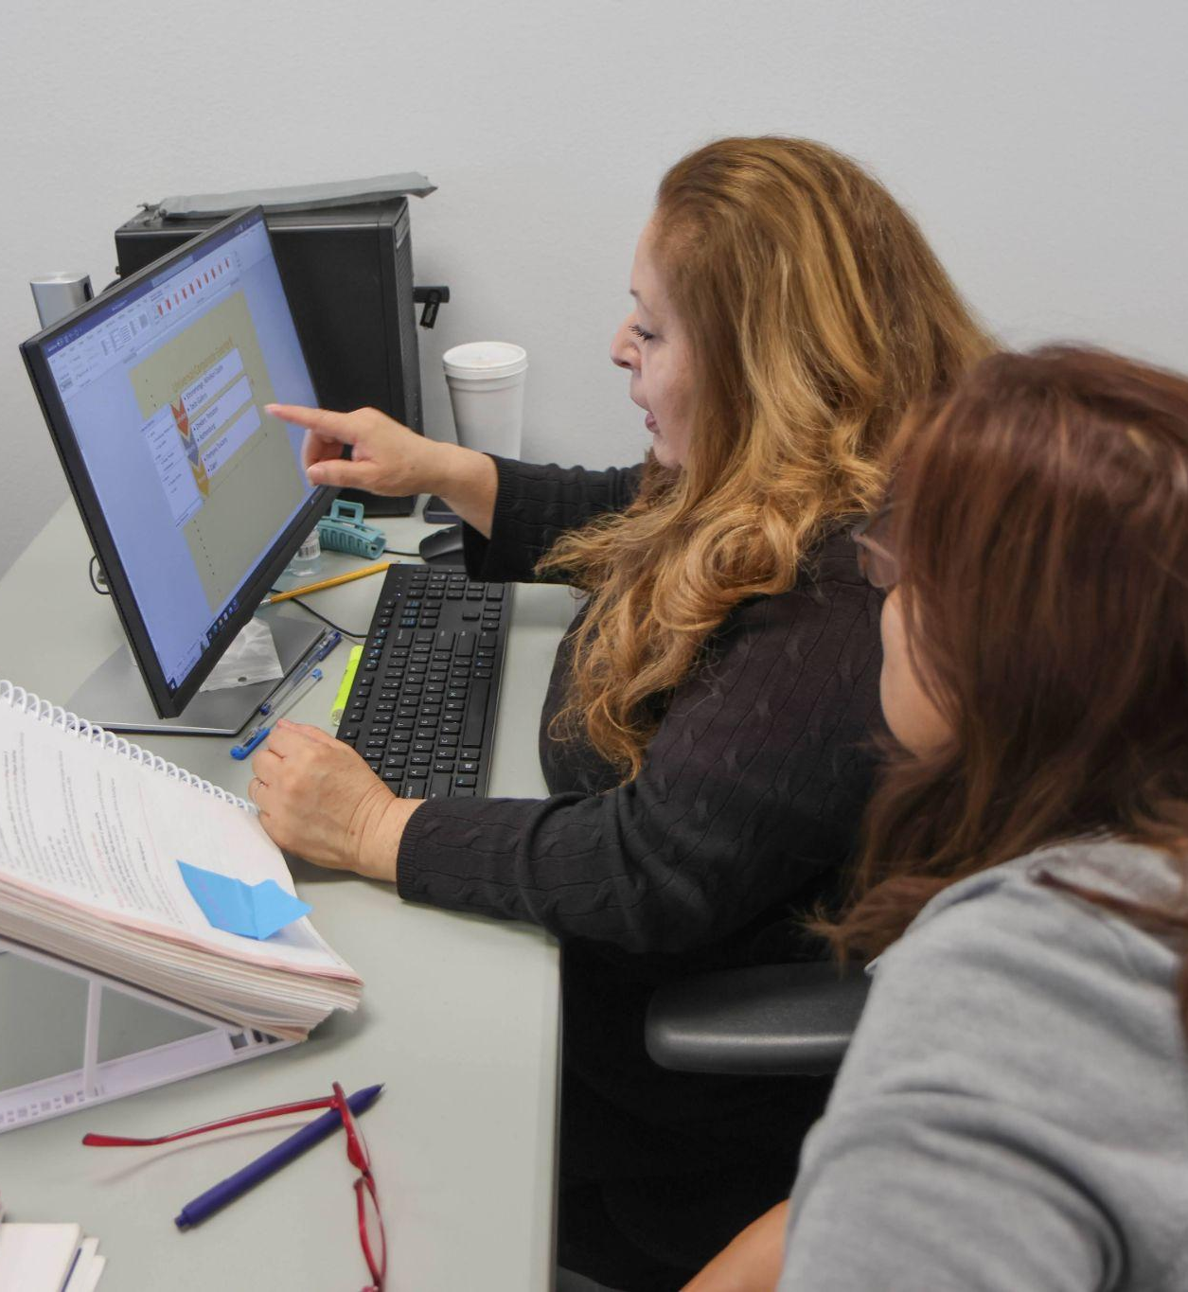
Importance of SEL in Adult Education
The significance of SEL in Adult Education
Goes beyond traditional academic content
Helps adult learners succeed in academic, professional, and personal lives
Notes:
🕧 = 3 minutes
Discuss the significance of integrating SEL in adult education.
Explain that SEL goes beyond traditional academic learning and focuses on developing essential life skills.
Highlight how SEL helps learners succeed not only in education but also in their personal and professional lives.
🗣️ Facilitation tip. Consider starting with a quick brainstorming, asking what educators perceive to be the benefits of incorporating SEL practices into classrooms and programs. Based on those responses, discuss the lists below.
As participants reflect on how SEL practices have positively impacted student learning, consider adding any of the following examples to help encourage and deepen the conversation.
Emphasize the positive impact of SEL on GED and ESL students, such as improved engagement, academic achievement, and overall well-being.
Highlight that when learners' social and emotional needs are met, they are often more motivated to participate actively in their learning journey.
Share examples or anecdotes of how SEL practices have positively impacted GED and ESL students' learning experiences.
In an ESL classroom, implementing SEL practices such as regular community-building activities and explicit teaching of social skills resulted in increased peer collaboration and support. Students reported feeling more connected to their classmates and expressed improved self-confidence in their language skills.
In a GED program, integrating SEL activities like goal-setting and reflection exercises helped students develop a growth mindset and resilience. As a result, learners showed increased persistence in overcoming challenges, and their overall academic performance and completion rates improved significantly.

Slide 8
Integrating SEL in the Classroom
Why it’s important and what it can look like:
The importance of creating safe and supportive learning environments
The benefits of integrating SEL into our classrooms
How SEL can be integrated into
Physical classrooms
Digital learning environments
Notes:
🕧 = 3 minutes
Continue explaining the importance of creating a safe and supportive learning environment for adult learners.
Emphasize that adult learners may have had previous negative educational experiences or face unique challenges.
Highlight the impact of a safe and supportive environment on learners' motivation, engagement, and overall well-being.
Emphasize that integrating SEL into the classroom helps learners feel accepted, supported, and engaged.
Discuss how SEL practices promote a sense of belonging, respect, and inclusivity among learners.
Highlight that SEL empowers learners to develop their social and emotional skills, leading to greater self-confidence and a positive learning experience.
Provide examples of how SEL can be integrated into both physical and digital learning environments.
In a physical setting, share examples such as morning check-ins to build connection, collaborative group activities that encourage teamwork and relationship-building, and regular opportunities for reflection and goal-setting.
For digital learning environments, suggest practices like virtual icebreakers, online discussion forums to foster communication and empathy, and incorporating SEL-themed digital resources or interactive platforms for self-reflection.

Slide 9
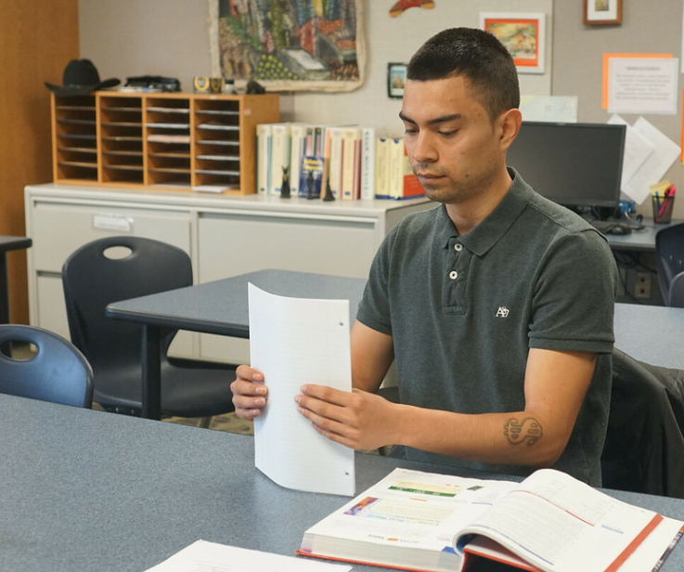
Core SEL Competencies
A framework for SEL
Self-Awareness
Self-Management
Social Awareness
Relationship Skills
Responsible Decision-Making
Notes:
🕧 = 3 minutes
The Collaborative for Academic, Social, and Emotional Learning created a framework with five core SEL competencies
Self-Awareness: The ability to recognize and identify emotions and how they influence behavior across contexts; the ability to recognize one’s strengths and areas for growth
Self-Management: The ability to manage one’s emotions, thoughts, and behaviors in different contexts to achieve personal goals
Social Awareness: The ability to understand and empathize with others from diverse backgrounds, cultures, and contexts
Relationship Skills: The ability to develop and maintain healthy relationships with others
Responsible Decision-Making: The ability to make constructive personal decisions and act accordingly
Explain each competency briefly, highlighting its importance and relevance to adult learners.

Slide 10
Discussion on SEL
SEL in our Classrooms
How have you seen social and emotional skills impact your students' learning experiences?
Think of a student where the strategy you identified was really important. Share that story with a neighbor.
Discuss with your groups and be prepared to share highlights of the conversation (including any examples!)
Notes:
🕧 = 10 minutes
Divide participants into small groups of 3-5 people
💻 Digital tools connection. If online, consider using a breakout room feature.
Assign each group a specific discussion question related to SEL.
🗣️ Facilitation tip. If participants are struggling to get started, consider providing a few examples (nested under each question)
"How have you seen social and emotional skills impact your students' learning experiences?"
"In my experience, integrating social awareness into the curriculum has had a significant impact. It has helped students develop empathy and understanding for others, fostering a positive classroom environment where students support and learn from each other."
"Supporting responsible decision-making strategies has empowered my students to make choices that align with their long-term goals. I've seen them take ownership of their learning, make informed decisions about their education, and demonstrate increased motivation and commitment."
"One strategy that has worked well for me is engaging in open and respectful communication. By actively listening to my students, valuing their perspectives, and providing constructive feedback, I have built trust and strengthened relationships in the classroom.”
"One strategy I’ve found effective is promoting self-reflection and self-management skills. By supporting students in reflecting on their own emotions, strengths, and areas for growth, they gain a deeper understanding of themselves. This self-awareness helps them regulate their own emotions, navigate challenges more effectively, and take ownership of their learning journey. It fosters a sense of empowerment and autonomy. As a result, adults become more proactive and engaged learners, actively driving their own growth and success."
“Think of a student where that strategy you identified was really important! Share that story with a neighbor.”
After the discussion time, bring the participants back to the main session.
Ask each group to select one representative who will share a brief summary of their group's key points and insights.
Allocate a few minutes for each representative to provide a concise overview, highlighting the most significant takeaways from their group's discussion.
Facilitate a brief discussion among all participants, encouraging them to reflect on the shared experiences and ideas.
Ask participants to reflect on instances where they observed changes in student engagement, motivation, or overall well-being due to the integration of SEL practices.

Slide 11
Creating an SEL-Inclusive Classroom
Brainstorming SEL strategies
Directions: Brainstorm SEL activities and strategies with your group.
Post ideas to each category on the shared Padlet.
Setting and achieving positive goals
Fostering empathy and positive relationships
Encouraging responsible decision-making
Supporting self-awareness and self-management
Notes:
🕧 = 20 minutes for the full activity: 10 minutes for small group brainstorming (this slide, #11) and 10 minutes for reflection (Slide 12)
Directions for the activity
Introduce the activity by explaining that participants will engage in a collaborative brainstorming session using the digital tool Padlet.
Share the Padlet board link or create a new board in advance and provide participants with access to it.
💻 Digital tools connection. Before the session, create the Padlet and <Store the Padlet link here>
You’ll want to use the “Group posts by section” in order to create columns. Learn more here.
Explain the categories for brainstorming on the Padlet board
Setting and achieving positive goals
Using Google Docs to write and track goals
Develop a vision board with Canva or Pinterest
Fostering empathy and positive relationships
Use Flipgrid or Padlet to create a virtual appreciation wall where learners can express gratitude and appreciation for their peers accomplishments or supportive actions
Create a virtual pen pal program with ePals where learners can connect with other students from around the world
Encouraging responsible decision-making
Use Microsoft Word to document important decisions made, reflect on the outcomes, and identify areas for improvement
Use iCivics to create simulations where learners are provided with realistic scenarios and challenges that require responsible decision-making
Supporting self-awareness and self-management
Use digital mood trackers like Daylio to help learners develop self-awareness by tracking their emotions and identifying patterns
Share mindfulness apps like Headspace or Calm to help learners practice mindfulness and relaxation apps to support the development of self-management and stress reduction
Instruct participants to add their ideas, strategies, and examples to the respective categories on the Padlet board.
Monitor the Padlet board as participants contribute and ensure that the ideas remain focused on the specific categories.
🗣️ Facilitation tip. If groups are struggling to get started, consider sharing one example to help nurture the conversation
Setting and achieving positive goals
Fostering empathy and positive relationships
Encouraging responsible decision-making
Supporting self-awareness and self-management

Slide 12
Reflecting on the SEL Brainstorm
Which strategies shared on Padlet resonate with you? Why do you find them effective or compelling?
Reflecting on your own teaching, how feasible do you think these strategies are to implement? Are there any specific challenges or considerations you anticipate?
What digital tools could be used to support these activities?
Notes:
🕧 = 20 minutes for the full activity: 10 minutes for small group brainstorming (previous slide #11) and 10 minutes for reflection on this slide (#12)
After the activity time, bring participants' attention back to the main session.
Review the ideas and strategies shared on the Padlet board together as a group.
Encourage participants to elaborate on their suggestions and share examples from their own experiences. You can help nurture the conversation with some of these examples.
Setting and achieving positive goals
Using Google Docs to write and track goals
Develop a vision board with Canva or Pinterest
Fostering empathy and positive relationships
Use Flipgrid or Padlet to create a virtual appreciation wall where learners can express gratitude and appreciation for their peers accomplishments or supportive actions
Create a virtual pen pal program with ePals where learners can connect with other students from around the world
Encouraging responsible decision-making
Use Microsoft Word to document important decisions made, reflect on the outcomes, and identify areas for improvement
Use iCivics to create simulations where learners are provided with realistic scenarios and challenges that require responsible decision-making
Supporting self-awareness and self-management
Use digital mood trackers like Daylio to help learners develop self-awareness by tracking their emotions and identifying patterns
Share mindfulness apps like Headspace or Calm to help learners practice mindfulness and relaxation apps to support the development of self-management and stress reduction
Facilitate a discussion by asking questions that prompt participants to reflect on the effectiveness and feasibility of the strategies shared.
Which strategies shared on the Padlet board resonate with you the most? Why do you find them effective or compelling?
Reflecting on your own teaching context, how feasible do you think these strategies are to implement? Are there any specific challenges or considerations you anticipate?
What digital tools could be used to support these activities?
Encourage participants to highlight strategies that resonate with them or that they are interested in trying out in their own classrooms.

Slide 13
What’s Next?
Chapter 7 of the Digital Learning Guidance provides more details and discussion of key strategies (see p. 102-103 for a helpful checklist)
The self-paced course on the OTAN website includes a multiple choice quiz and extension activities
Continue finding opportunities to simplify program materials to improve readability and accessibility.
Notes:
🕧 = 5 minutes
Spend a few minutes reviewing key concepts from the session, including suggestions for continuing to learn about both frameworks:
Today, we explored Ch 7 of the Digital Learning Guidance, which looks at the importance of integrating social and emotional learning (SEL) in adult education, providing practical strategies for creating an inclusive and supportive learning environment for adult learners.
As a quick overview of key concepts:
Overview of SEL and its importance in Adult Education:
Define SEL: Social and Emotional Learning involves the development of skills and competencies to recognize and manage emotions, establish positive relationships, make responsible decisions, and set and achieve goals.
Provide an overview of SEL framework
Self-Awareness
Self-Management
Social Awareness
Relationship Skills
Responsible Decision-Making
Highlight the impact of integrating SEL in the classroom and the benefits for adult learners:
When learners' social and emotional needs are met, they are more motivated to participate actively in their learning journey.
SEL helps learners succeed not only in education but also in their personal and professional lives.
Consider bookmarking the Padlet to reference over time as you look for ideas on how to incorporate SEL into your programs and classrooms!

